Slide 1
BeDIPS-DE Mockup
Johnson Su, Eive Chen, Leah Chang
2016/07/21

Slide 2
Date | Revision | Authors | Comments
2016/07/18 | 1 | Johnson Su, Eive Chen, Leah Chang | Add mockup
2016/07/19 | 2 | Johnson Su, Eive Chen, Leah Chang | Add worker’s mockup
2016/07/20 | 3 | Johnson Su, Eive Chen, Leah Chang | Add Beacon installation SOP
2016/07/27 | 4 | Johnson Su, Eive Chen, Leah Chang | Add user’s dashboard

Slide 3
B-DE for Designer

Slide 4
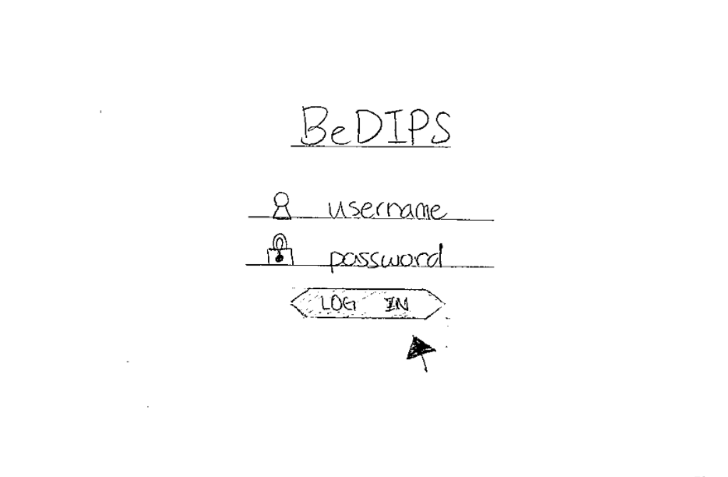

Slide 5
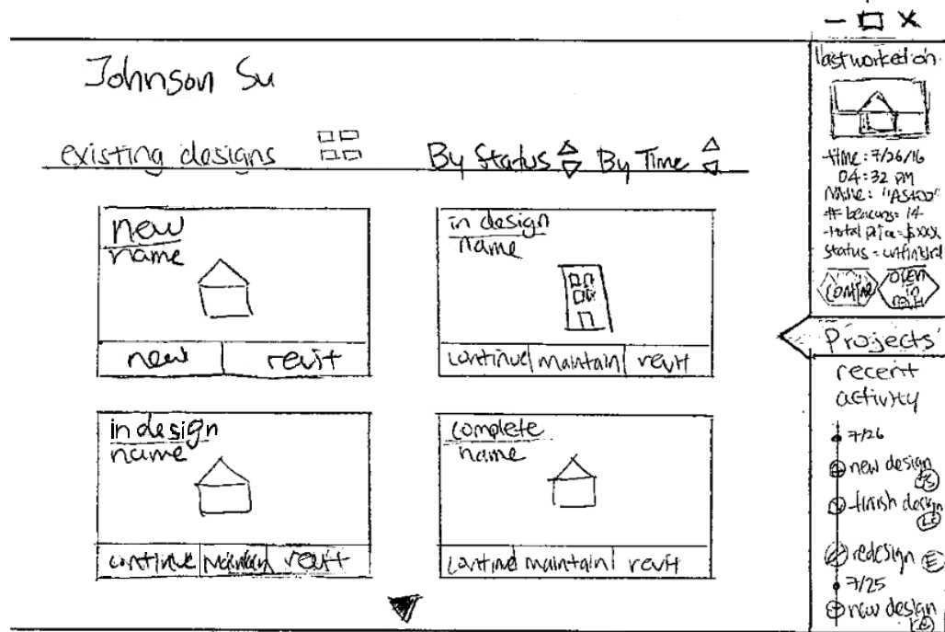
User Dashboard

Slide 6
User Dashboard

Slide 7
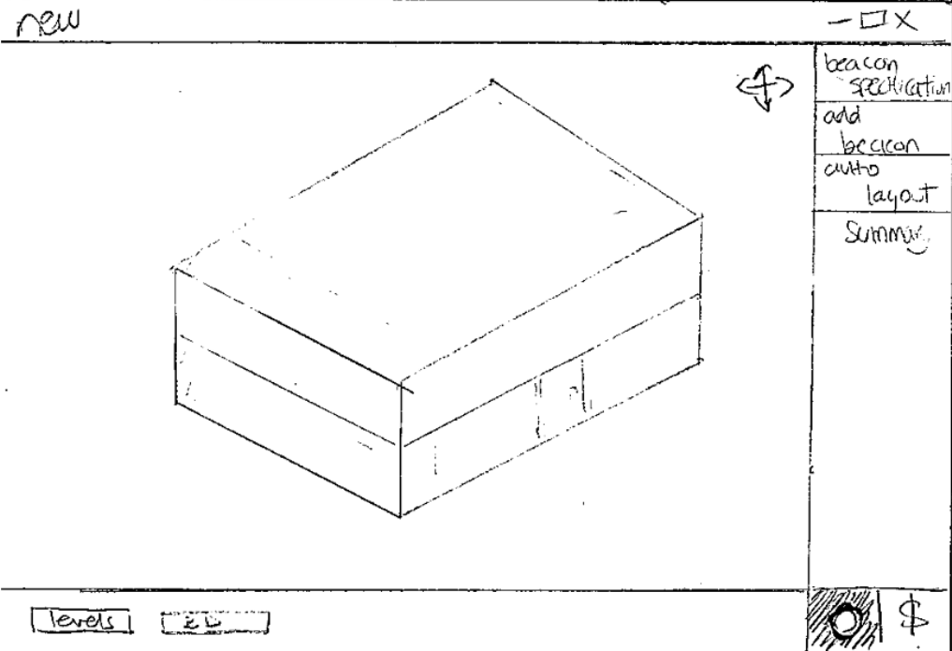
Opens New Design in Popout Window

Slide 8
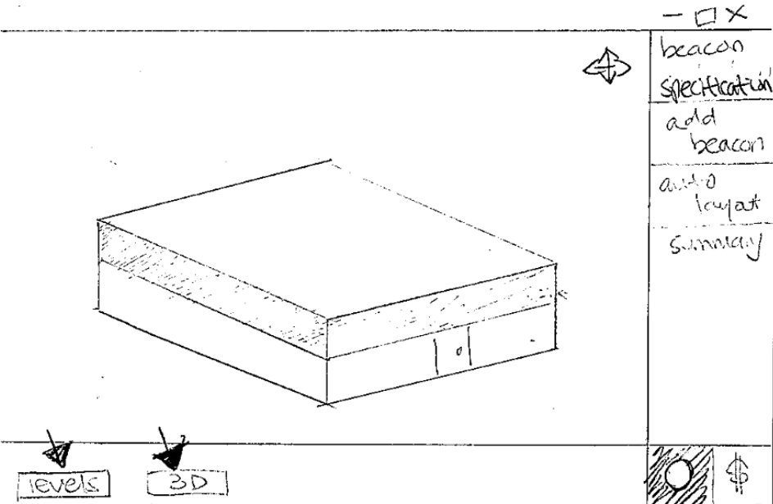

Slide 9
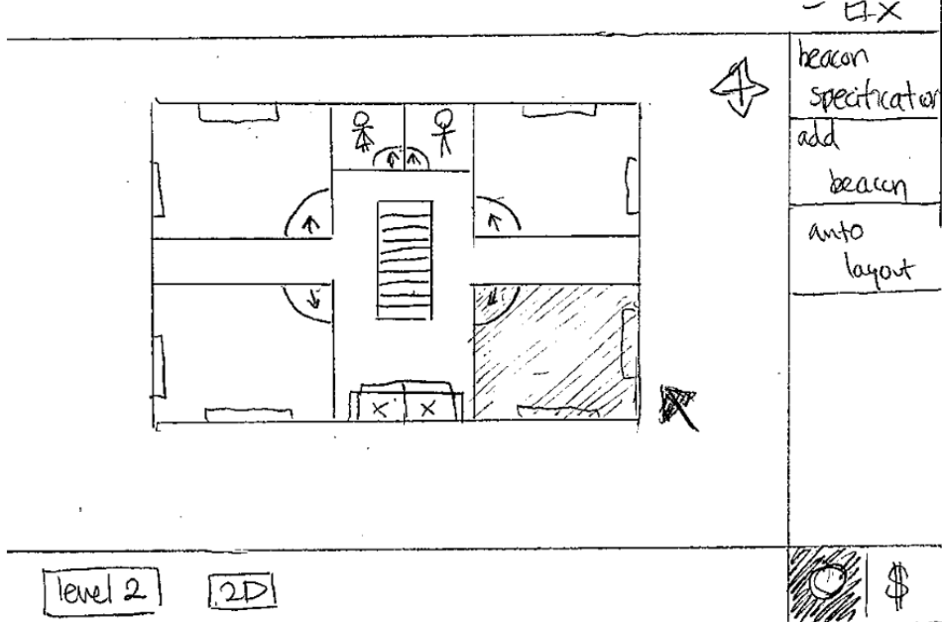

Slide 10
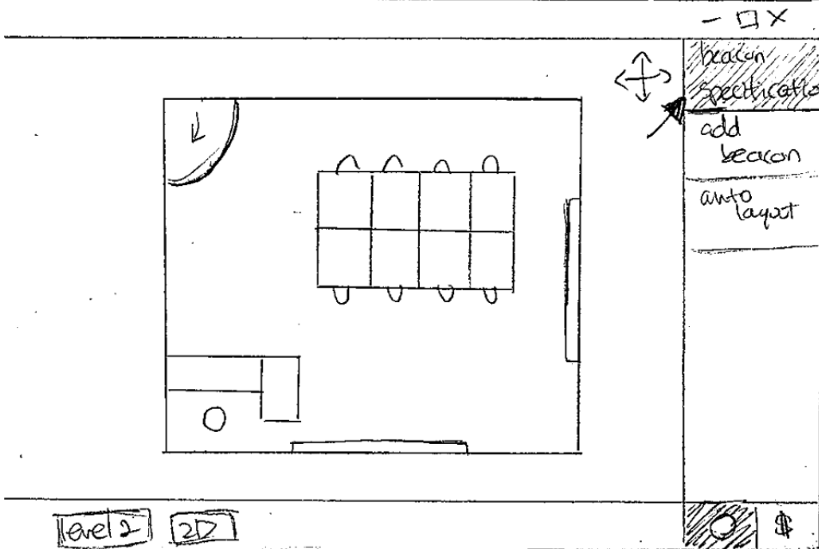

Slide 11
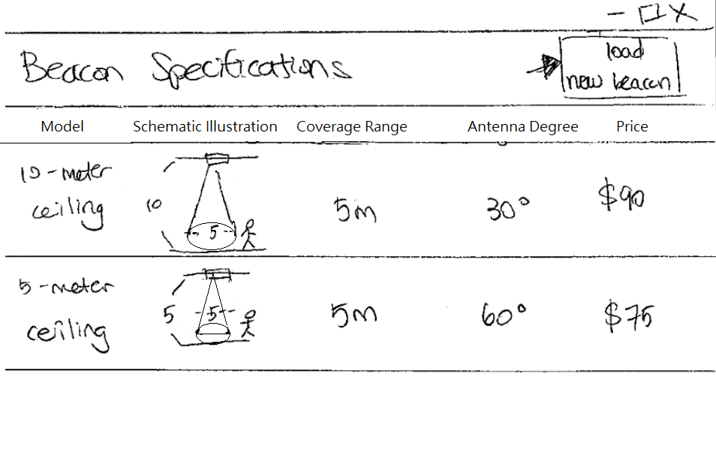
Opens Beacon Specifications in Popout Window

Slide 12
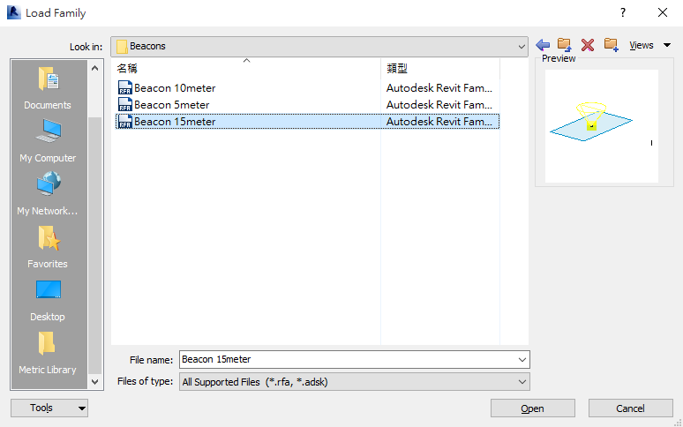

BeDIPS Development Environment
Load
New Beacon
Beacon Specifications
Model | Schematic Illustration | Coverage Range | Antenna Degree | Price
10-meter Ceiling |  | 5m | 30°
5-meter Ceiling |  | 5m | 60°
90$
75$

Slide 13
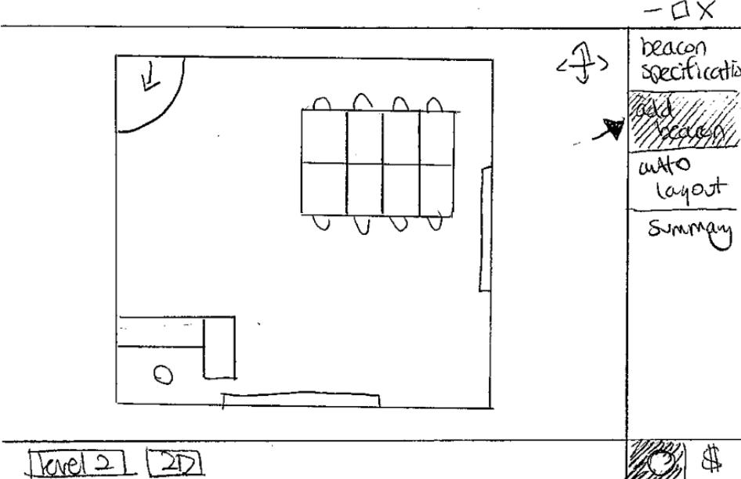
Back to New Design Popout Window

Slide 14
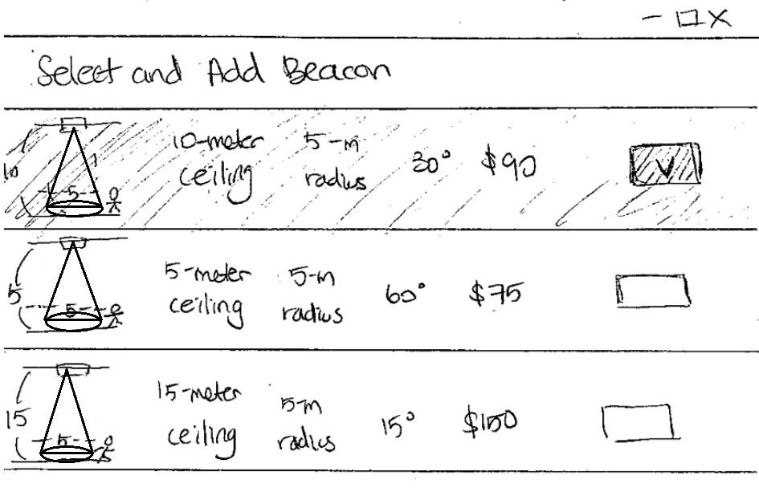
Opens Add Beacon in Popout Window

Slide 15
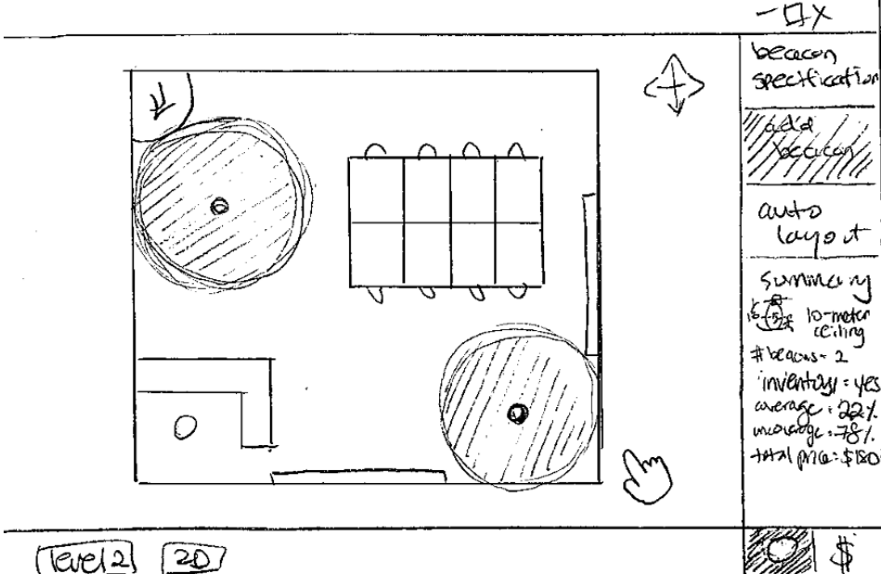
Back to New Design Popout Window

Slide 16
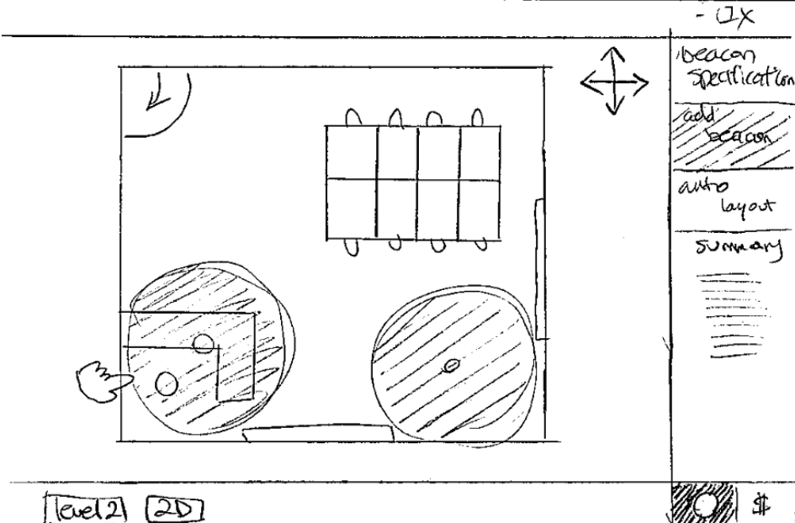

Slide 17
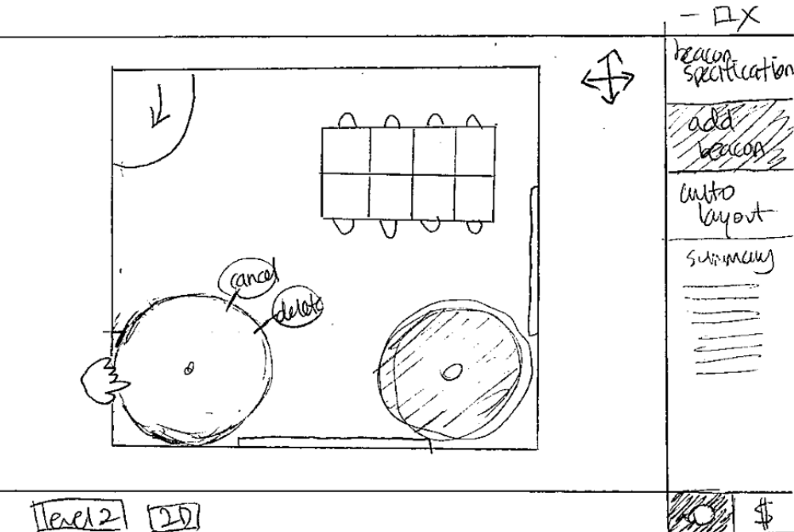

Slide 18
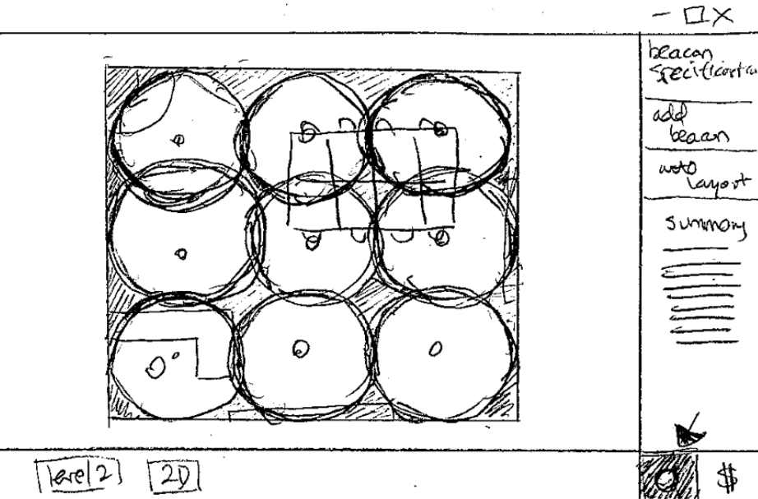

Slide 19
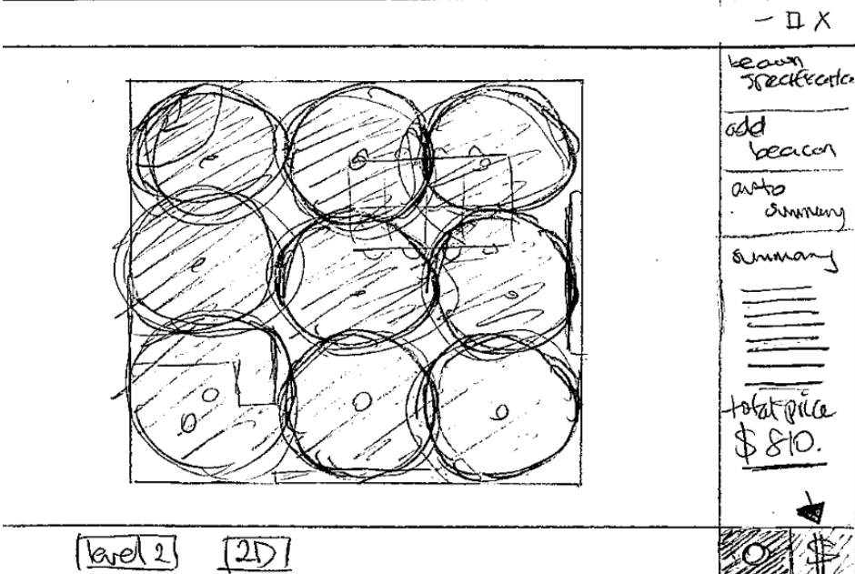

Slide 20
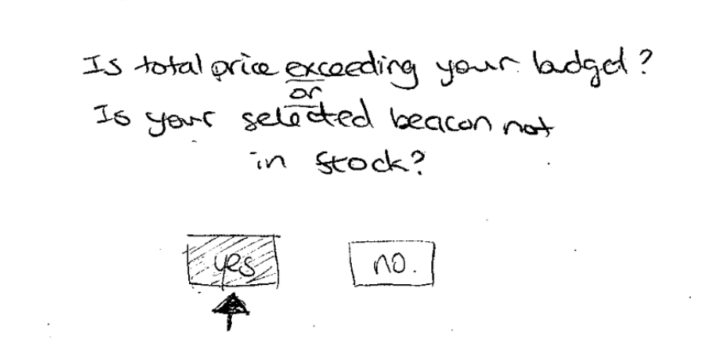
Opens Confirmation in Popout Window

Slide 21
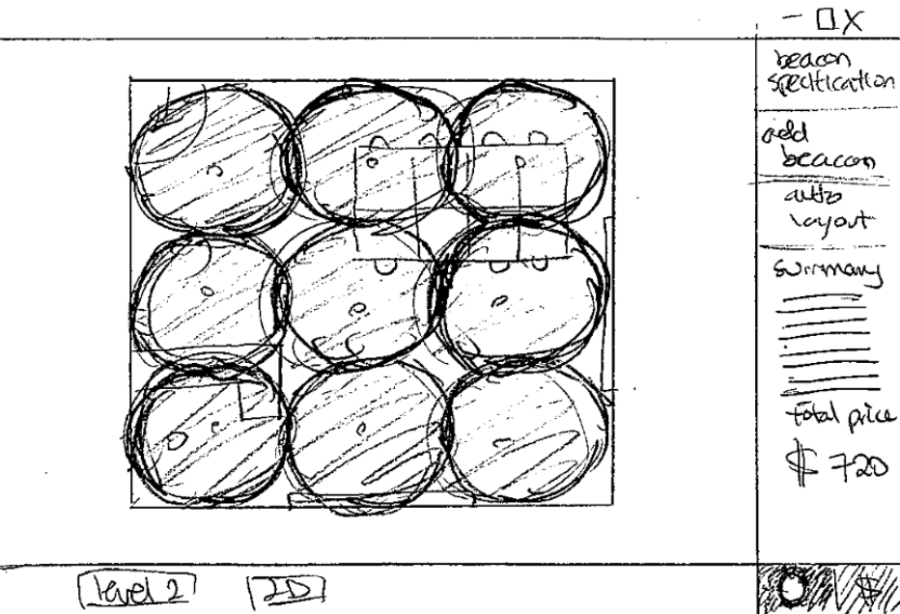
Back to New Design Popout Window

Slide 22
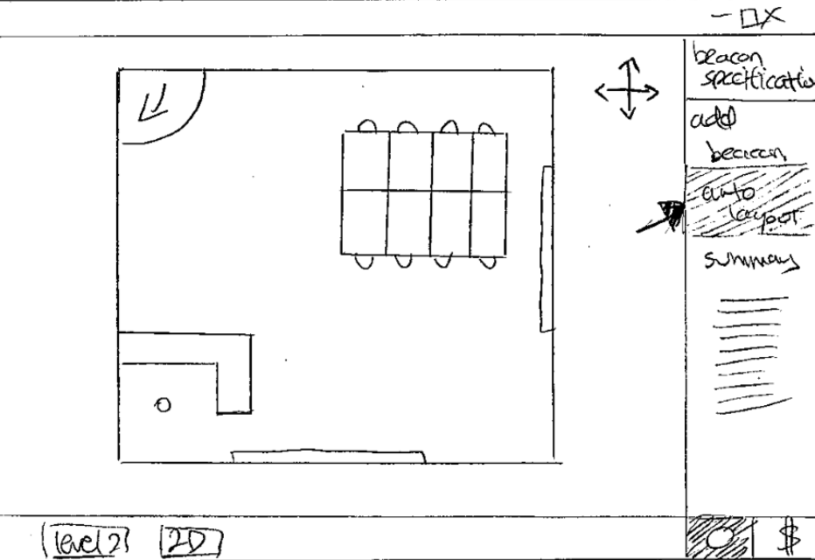

Slide 23
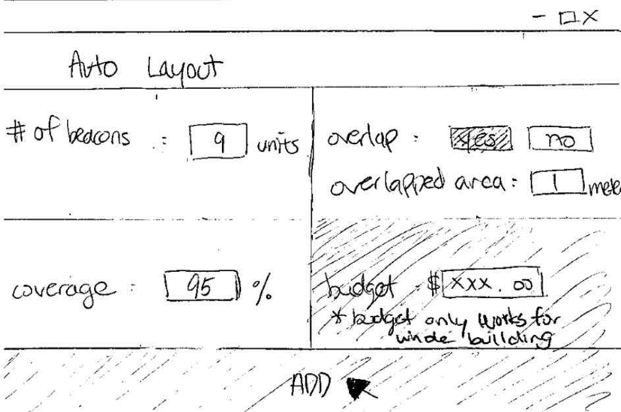
Opens Auto Layout in Popout Window

Slide 24
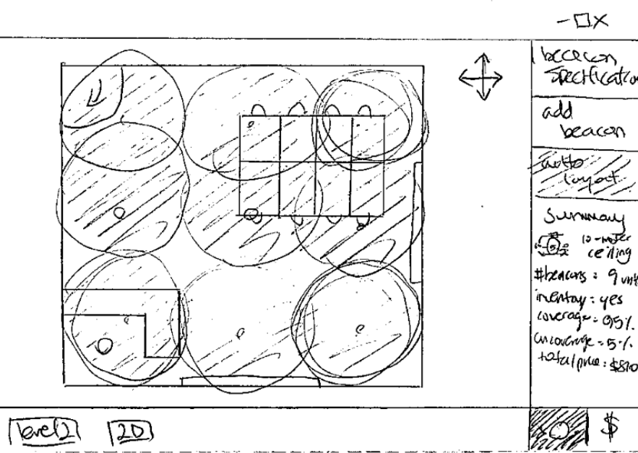
Back to New Design Popout Window

Slide 25
User Dashboard

Slide 26
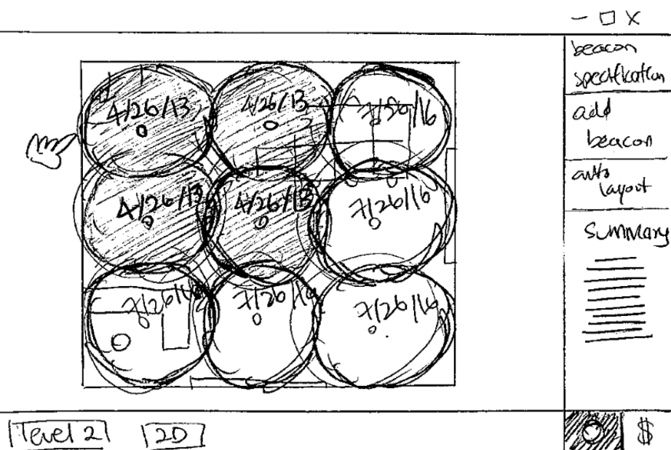
Opens Maintain in Popout Window

